Slide 1
What do THEY believe and how do they compare

Slide 2
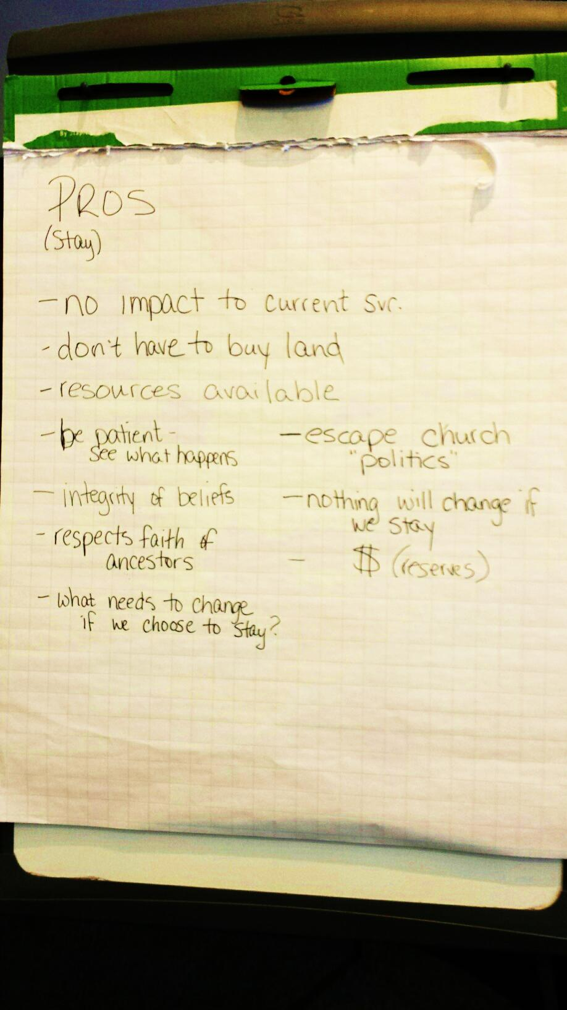
Last week we discussed

Slide 3
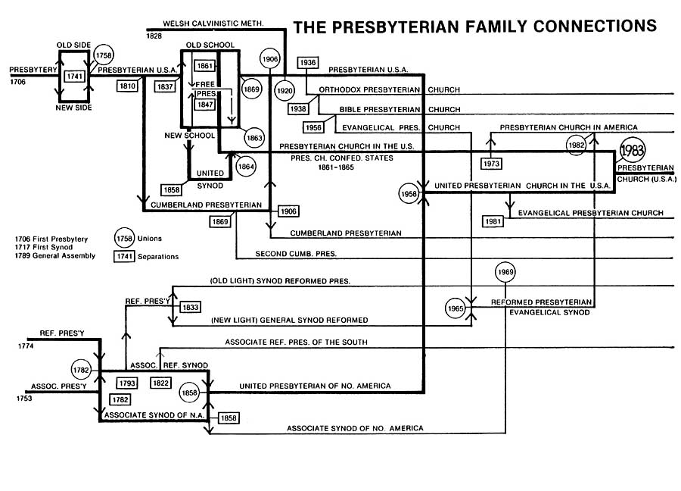

Slide 4
What They Believe

Slide 5
What They Believe

Slide 6
What They Believe

Slide 7
What They Believe

Slide 8
What They Believe

Slide 9
What They Believe

Slide 10
Your Elders want to present information on one more choice not included above,
a choice within the PC (USA)

Slide 11
What They Believe
We are committed to ministry within the PC(USA) because God calls us here. When asked why he would associate with tax collectors and sinners, Jesus answered, “It is not the healthy who need a doctor but the sick… I have not come to call the righteous but sinners.” (Matthew 9:12, Luke 5:31) We are commissioned by the same Lord to remain within the PC(USA)—not as those who agree with the current trajectory of our denomination, but as missionaries called to teach and model the Good News of Jesus Christ within a structure that is in deepening trouble.

Slide 12
What They Believe
Why Remain within the PC(USA)?
God’s call to remain in the PC(USA) can take many forms. For some, it involves their history, place, or position within the denomination. Others feel missionary zeal for reaching the people they know best with the gospel during a season of theological confusion, cultural captivity, and gospel amnesia. For still others, The Fellowship provides a covenanted community in which they can discern their future direction and affiliation. No matter why people remain in the PC(USA) or wherever else they eventually sense God calling them, there is one inevitable reality—deep change.

Slide 13
What They Believe
Core Values
Jesus-shaped Identity We believe Jesus Christ must be at the center of our lives and making disciples of Jesus at the core of our ministry.
Biblical Integrity We believe the Bible is the unique and authoritative Word of God, which teaches all that is necessary for faith and life. The prominence of God’s Word over our lives shapes our priorities, and the unrivaled authority of the Bible directs our actions to be in concert with Christ’s very best for our lives.
Thoughtful Theology We believe in theological education, constant learning, and the life of the mind, and celebrate this as one of the treasures of our Reformed heritage.

Slide 14
What They Believe
We fully understand and accept there will be times when remaining faithful to our theological and confessional heritage, and to the voice of the Church around the world, will cause us to stand in direct opposition to current policies of the PC(USA). As a covenanted order, we will stand together, and will attempt at all times to speak God’s Truth as we know it
with humility and grace.

